Slide 1



HR Analytics and Prediction of Employee Attrition
Kesav Adithya Venkidusamy
DSC680-T301 Applied Data Science, Bellevue University
Professor Catherine Wiliams
Notes:
Today I would like to present my findings in a predictive analytics project to determine employee attrition rate based on a set of variables.

Slide 2
Summary
Introduction
Data Mining & EDA
Predictive Modeling & Analysis
Findings & Recommendation
Ethical Considerations

Slide 3

Introduction
Employee retention strategies are integral to the success and well-being of a company. Attrition is a problem that impacts all businesses, irrespective of geography, industry and size of the company.
Employee attrition leads to significant costs for a business, including the cost of business disruption, hiring new staff and training new staff.
There are often many reasons why employees leave an organization, and in this case study, I will explore some of the key drivers of employee attrition
3

Slide 4
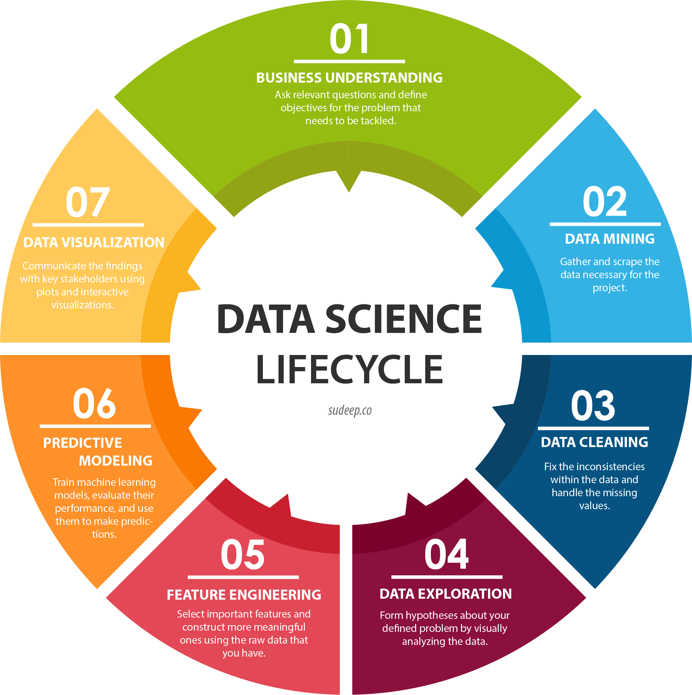
Employee Attrition Prediction Life Cycle
Notes:
The data science life cycle represented on this slide, shows the process used to develop the data and create a model to determine predictions. I started with the problem definition which can be the most difficult step in the project. This step is where we formulate the question I am trying to answer. Once that has been defined, I move to data mining and data preparation. In this phase I evaluate data, make sure it meets my needs, and start the cleaning process. This phase also includes creating visualizations to show another angle of the data and make any needed changes to prepare for modeling. Feature engineering involves scaling data so that it is represented equally for the modeling process. Next the data structure and the evaluation of visualizations will help to decide the best model to use. Depending on that outcome we may choose to reevaluate using a different model. This process continues until the outcomes needed to use with future data. A full evaluation of the model helps confirm the choice for predictions.

Slide 5
Data Mining - Data Structure
Feature Name | Feature Description | Feature Type
Attrition | Person has left the company or not | Target
Age | Age of the person | Continuous
BusinessTravel | How frequently the person travels | Discrete
DailyRate | Daily Rate for the employee | Continuous
Department | Department of the person | Discrete
DistanceFromHome | Distance of the company from home | Continuous
Education | Education of the person | Discrete
EducationField | Education field of the person | Discrete
EmployeeCount | Count of Employee | Discrete
EmployeeNumber | Employee id of the person | Continuous
EnvironmentSatisfaction | Environment Satisfaction | Discrete
Gender | Gender | Discrete
HourlyRate | Hourly rate for the employee | Continuous
JobInvolvement | Involvement in Job | Discrete
JobLevel | Job Level | Discrete
Features | Feature Description | Feature Type
JobRole | Job Role | Discrete
JobSatisfaction | Job Satisfaction | Discrete
MaritalStatus | Marital Status of Employee | Discrete
MonthlyIncome | Monthly Income of the person | Continuous
MonthlyRate | Monthly Rate | Continuous
NumCompaniesWorked | Number of Companies worked | Discrete
Over18 | Over 18 years | Discrete
OverTime | Worked over time | Discrete
PercentSalaryHike | Percentage of Salary Hike | Continuous
PerformanceRating | Performance Rating | Discrete
RelationshipSatisfaction | Relationship Satisfaction for the employee | Discrete
StandardHours | Standard work hours | Discrete
StockOptionLevel | Stock Option Level given to the employee | Discrete
TotalWorkingYears | Total Number of years worked | Continuous
TrainingTimesLastYear | Training times attended during last year | Continuous
WorkLifeBalance | Work Life Balance | Discrete
YearsAtCompany | Number of years with current company | Continuous
YearsInCurrentRole | Number of years in the current role | Continuous
YearsSinceLastPromotion | Number of years since last promotion | Continuous
YearsWithCurrManager | Number of years with current manager | Continuous
5
Notes:
The data for my project is a fictional dataset created by IBM data scientists. The problem statement of this project is to identify the features which are mostly related to or affecting the attrition in an organization. With the dataset having around 1500 records, I will be able to predict an answer to our problem statement. The dataset consists of 34 features of which 26 are numerical and rest are categorical with “attrition” being the target. The target variable income contains 2 values. It will indicate if the employee left the company or continuing in the organization.

Slide 6

Data Cleaning
Missing/Null Check - No missing value present in any of the feature
Duplicate Check - No duplicate value in the dataset
Unwanted features Removal – The below irrelevant features are removed from the dataset
EmployeeCount - constant value "1“
StandardHours - constant value "80“
Over18 - constant value "True“
EmployeeNumber - Employee number is key column which can also be removed
StockOptionLevel - I believe this is stock options given to the employees having values between 1 to 3;
6
Notes:
As part of first step in data cleaning, null and duplicate checks have been performed on the data and found neither null values in any of the feature nor duplicate values. In addition, I have removed all unwanted features listed in this slide from the dataset.

Slide 7
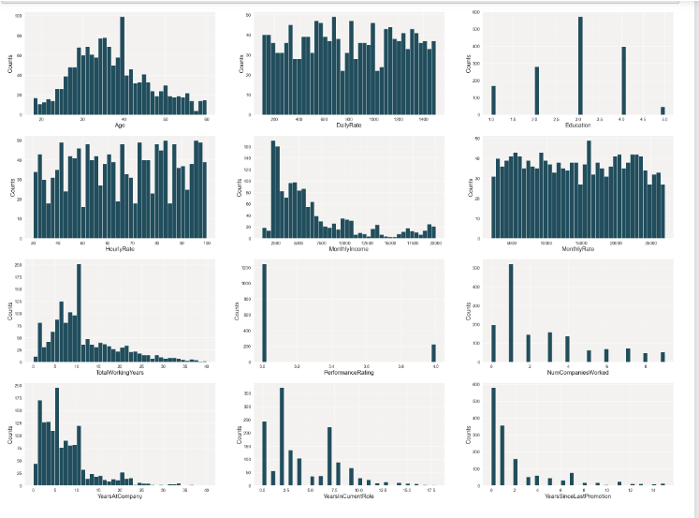
EDA - Numerical Variables
Age
Daily Rate
Education
Hourly Rate
Monthly Income
Monthly Rate
TotalWorkingYears
PerformanceRating
NumCompaniesWorked
YearsAtCompany
YearsInCurrentRole
YearsSinceLastPromotion
7
Notes:
On analyzing numerical variables through Histogram I see Age and Education are nearly normalized, with majority of the values occur at the middle (ages falling in the 40-50 and 3 for education). DailyRate, HourlyRate, MonthlyRate features are uniform where every value in a dataset occurs roughly the same number of times. PerformanceRating feature has Only 2 values are present for this feature with maximum at 3 and minimum at 4. YearsAtCompany, YearsSinceLastPromotion, YearsInCurrentRole, MonthlyIncome features are right-skewed. Finally, NumCompaniesWorked, TotalWorkingYears features are also kind of right skewed. However, the peak occurred at the middle (1 for NumCompaniesWorked and 10 for TotalWorkingYears)

Slide 8
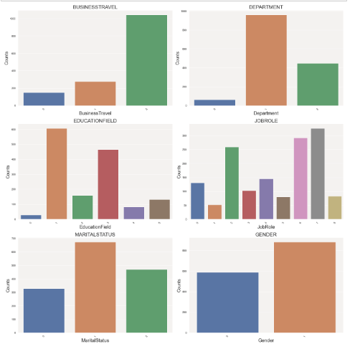
EDA - Categorical Variables
Business Travel
Department
EducationField
JobRole
MaritalStatus
Gender
8
Notes:
Looking at the categorical features, BusinessTravel has 3 unique values with more number of records (> 1000) for "Travel_Rarely". The feature Department has 3 unique values with more number of records for R&D Department and least number of records for HR department. Education has 6 different values with more people falling under Life Science and Medical and less number of people HR and Other. JobRole has many values with more people falling under SalesExecutive, Research Scientist, Laboratory Technician and less people under the job roles sales representative, research director and HR. MaritalStatus has 3 distinct values with most of the people falling under married and less number of people under Divorced. Finally, Gender has 2 distinct values Males and Female with more number of records for Males compared to Female.

Slide 9
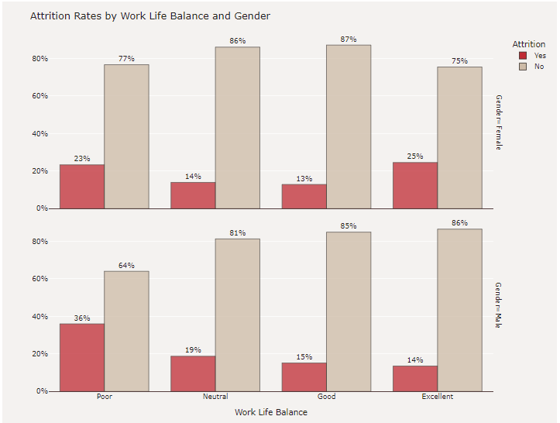
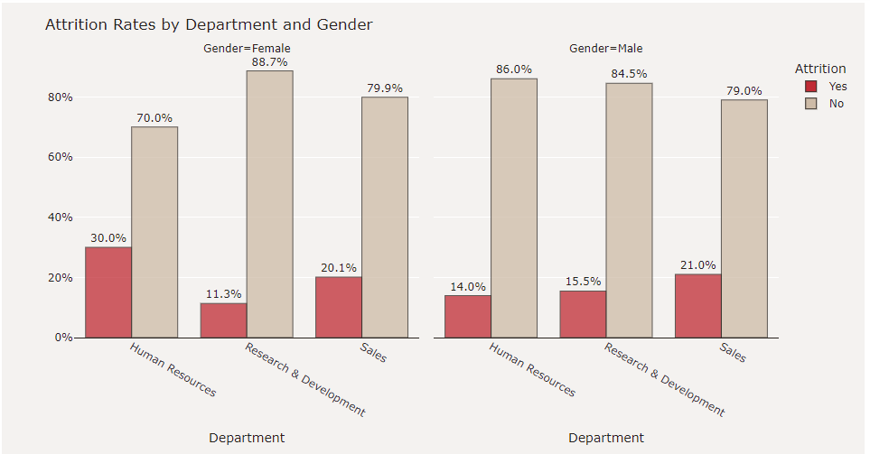
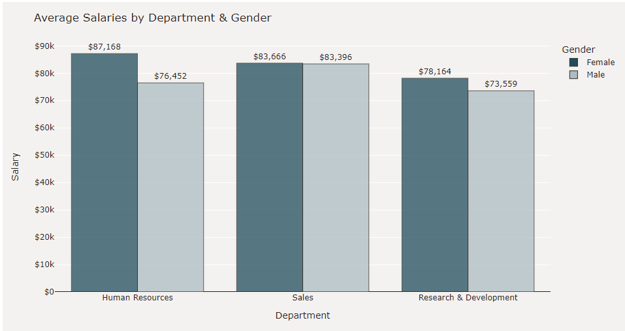
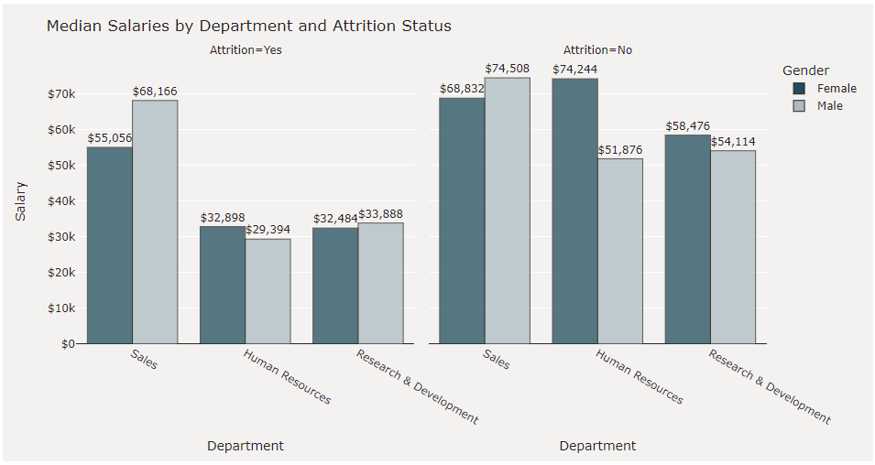
EDA - Target Variable “Attrition” Analysis
9
Notes:
On analyzing the target variable, I found Women in Human Resources experienced the highest amount of turnover, with nearly 1 out of every 3 women in HR leaving the company. Sales department comes 2nd and Research & Development comes third. For men, the highest turnover occurred in the Sales department with nearly 21%. The remaining departments Research and Development and HR are more or less experiencing similar rate of attrition (~15%).
Among women with the highest rated work life balance, 1 out of 4 left the company, the highest proportion among the ratings for women. Across each department, the average salary for women have higher salaries than men. In comparison to current employees, former employees had lower median salaries across all three departments. In Human Resources and Research and Development departments, women tend to have higher median salaries than men.

Slide 10
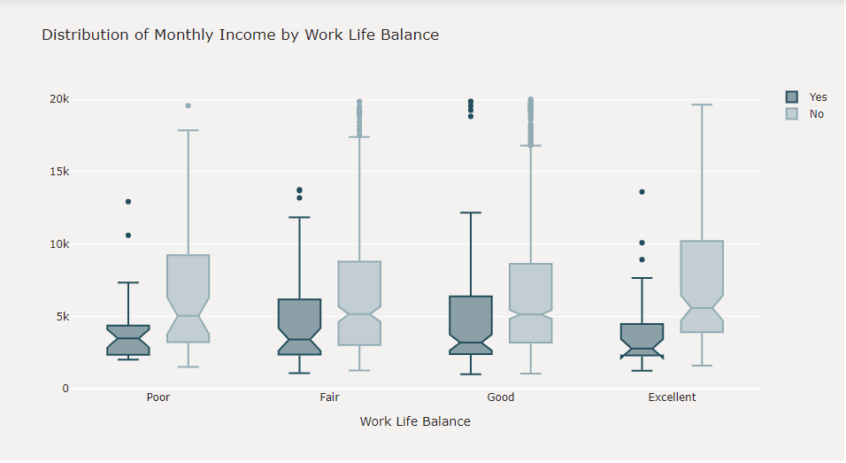
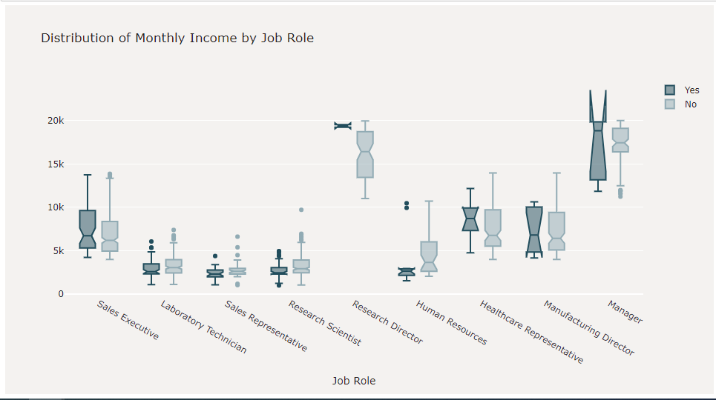
EDA - Distribution of Monthly Income by Work Life Balance and Job Role
The Attrition rate is high among the people who have "Good" work life balance earning median monthly income of 3202 dollars. However, the attrition rate is less among the people who have "Excellent" work life balance earning median monthly income of 2785 dollars; The people with "Fair" work life balance comes next.
The attrition rate is high among "Managers", "Manufacturing Director" and "Sales Executives" whereas it is low for "Research Director" and "Sales Representative"; So, "Research Director" and "Sales Representative" are not willing to quit the company often whereas "Managers", "Manufacturing Director" and "Sales Executives" often change their companies.
10
Notes:
The Attrition rate is high among the people who have "Good" work life balance earning median monthly income of 3202 dollars. However, the attrition rate is less among the people who have "Excellent" work life balance earning median monthly income of 2785 dollars; More number of people who have "Excellent" work life balance are continuing in the company as expected. Also, the attrition rate is high among "Managers", "Manufacturing Director" and "Sales Executives" whereas it is low for "Research Director" and "Sales Representative"; So, "Research Director" and "Sales Representative" are not willing to quit the company often whereas "Managers", "Manufacturing Director" and "Sales Executives" often change their companies.

Slide 11
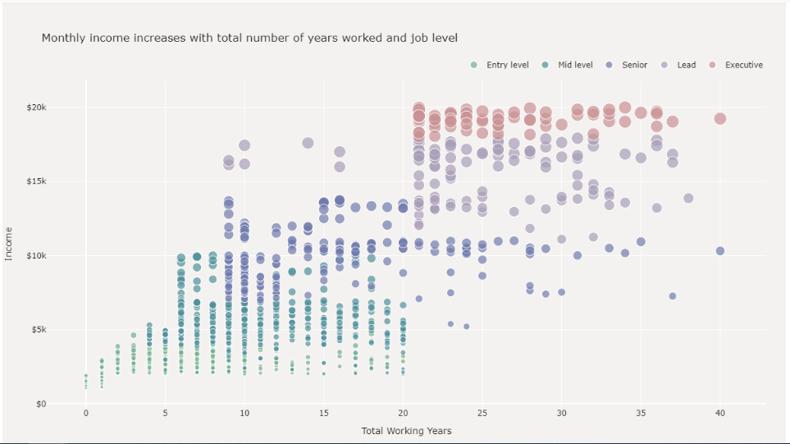
EDA – Scatter Plot for Monthly Income with total number of years worked and Job Role
Monthly income is positively correlated with total number of years worked and there is strong association between an employee's earnings and their job level.
11
Notes:
Based on the scatterplot above, monthly income is positively correlated with total number of years worked and there is strong association between an employee's earnings and their job level.

Slide 12
Feature Engineering
The below methods were applied on the features prepping them for model building
Label Encoder
SMOTE
12
Notes:
Label Encoding is a popular encoding technique for handling categorical variables. In this technique, each label is assigned a unique integer based on alphabetical ordering. Since the values present in the target variable are extremely unbalanced, “SMOTE” method is leveraged to balance the data. SMOTE is an oversampling technique where the synthetic samples are generated for the minority class

Slide 13
Predictive Modeling
Model | Definition | Pros | Cons
Logistic Regression | Predicts a dependent data variable by analyzing the relationship between one or more existing independent variables | Probabilistic Approach, gives info about statistical significance of features | the assumption of linearity between the dependent variable and the independent variables
Decision Tree | A series of sequential decisions made to reach a specific result | Interpretability, no need for feature scaling, works on both linear/nonlinear problems | Poor results on small datasets, overfitting can easily occur
Random Forest | A forest of randomly created decision trees, a combined output of individual decision trees to generate the final output. | Powerful and accurate, good performance on many problems including nonlinear | No interpretability, overfitting can easily occur, need to choose the number of trees
13
Notes:
For this project, we built 3 models – Logistic Regression, Decision Tree, and Random Forest.
Logistic Regression predicts a dependent data variable by analyzing the relationship between one or more existing independent variables. It gives statistical information about the features and their significance to the prediction. The major limitation of Logistic Regression is the assumption of linearity between the dependent variable and the independent variables.
Decision Tree is a series of sequential decisions made to reach a specific result. It works for a varied range of problems including linear and nonlinear. This model may result in poor evaluation on small datasets.
Random Forest is as the name goes, a forest of randomly created decision trees, a combined output of individual decision trees to generate the final output. It is very powerful and generally has a good performance on many problems, although the number of trees need to be chosen to evaluate its efficiency.

Slide 14
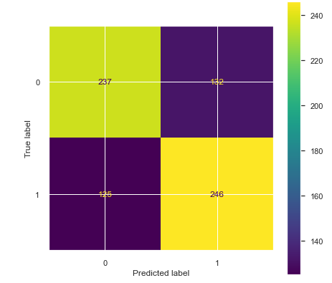
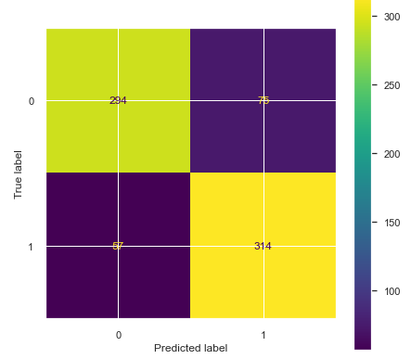
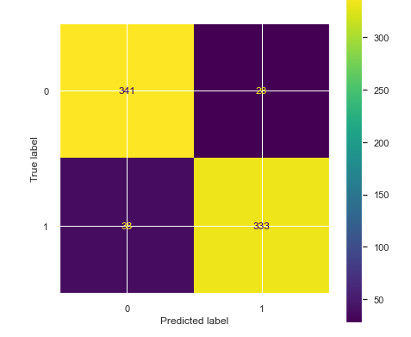
Confusion Matrix
Logistic regression
Decision Tree
Random Forest
14
Notes:
From the confusion matrix I can see, that the accuracy for the Logistic regression was 65.27%. The score turned out to be poor. The false negatives also seem to be higher in this method. The accuracy score for Decision Tree model came to 82% which is excellent compared to logistic regression. We observe that the model did seem to improve the predictions but still false negative seems little high. The accuracy score for Random Forest model was observed to be at about 91% which is the highest so far and best to predict attrition of the employees.

Slide 15
Model Efficiency Measures
Accuracy - Accuracy represents the number of correctly classified data instance over the total number of data instances
F1 Score: F1-Score is a metric which takes both precision and recall into account.
Precision: Positive predictive value
Recall: true positive rate
AUC Score: What area under the ROC curve describes good discrimination? We will use the following rule of thumb
0.5: This suggests no discrimination, so we might as well flip coin
0.5-0.7: We consider this as poor discrimination, not much better than a coin toss
0.7-0.8: Acceptable discrimination
0.8-0.9: Excellent discrimination
>0.9: Outstanding discrimination
15
Notes:
These are the measures I have used to measure model efficiency

Slide 16
Model Efficiency
Model | Standard Scalar | Accuracy | F1 Score (Income <=50K) | F1 Score (Income >50K) | AUC Score
Logistic Regression | No | 65.27% | 0.65 | 0.66 | 0.71
 | Yes | 81.62% | 0.83 | 0.82
Decision Tree | No | 82.16% | 0.83 | 0.82 | 0.83
 | Yes | 82.16% | 0.83 | 0.82
Random Forest | No | 91.08% | 0.91 | 0.91 | 0.97
 | Yes | 90.81% | 0.91 | 0.91
16
Notes:
Initially, all three algorithms (logistic regression, decision tree and random forest) have been applied on the dataset containing all features without standardscalar. We see random forest gives the highest score of 91.08% compared to other 2 models. Then, we applied Standardscalar on the dataset and applied all three models again. We see improvement in score for logistic regression. However, decision tree and random forest gives the more or less the same score.

Slide 17
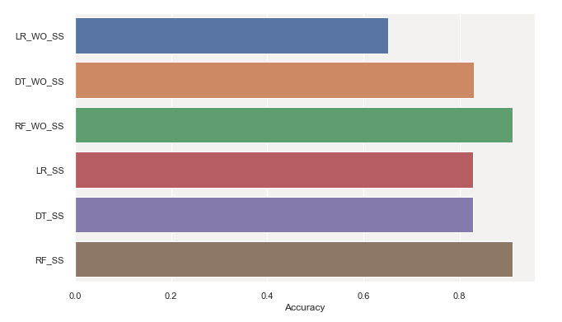
Model Efficiency – Score Chart
17
Notes:
Chart showing the scores of different approaches we have taken. Among all Random forest applied on the dataset without standardscalar gives the highest score.

Slide 18
Analysis - Best Performing Features
Pearson's correlation matrix Feature correlation to target variable “Attrition"
Chi-Squared (X2) Test 5 Best features correlated to “Attrition"
Using Feature Importance of Random Forest Classifier
18
Notes:
Observations were made to determine the best performing features. We used the Pearson's correlation matrix, Chi-Squared Test, and feature importance of the random forest classifier to make these determinations. Each one is explained in greater detail on the next three slides.

Slide 19
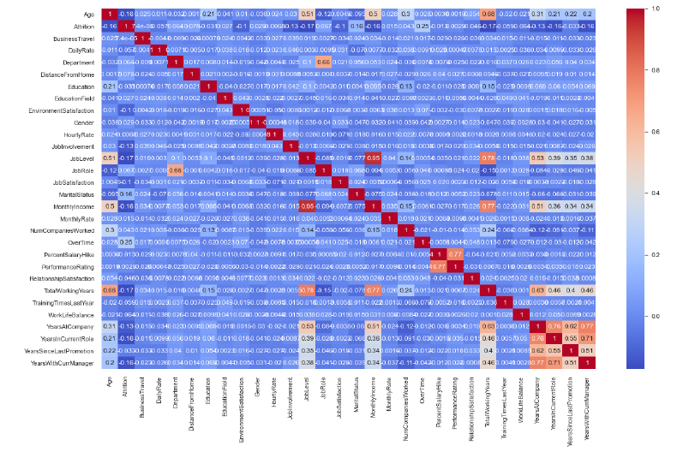
Pearson’s Correlation Matrix
Positive Correlation:
OverTime
MaritalStatus
DistanceFromHome
Negative Correlation:
TotalWorkingYears
YearsInCurrentRole
MonthlyIncome
19
Notes:
The Pearson's correlation matrix does a comparison of the variables to our target variable attrition. Overtime, MaritalStatus, DistanceFromHome are positively correlated with the target Attrition and TotalWorkingYears, YearsInCurrentRole and MonthlyIncome are negatively correlated.

Slide 20
Chi-Squared (X2) Test - 5 Best features
Years At Company
Years In Current Role
Total Working Years
Monthly Income
Daily Rate
20
Notes:
Another method to test the dependency of a variable on the target variable is to do a Chi-squared test. With this method we were able to determine that TotalWorkingYears, YearsAtCompany, MonthlyIncome, DailyRate, YersInCurrentRole were the best features.

Slide 21
Feature Importance of Random Forest Classifier
Monthly Income
Years At Company
Job Satisfaction
Job Involvement
Job Level
21
Notes:
Our last method of determining features of importance was the random forest classifier. The random forest classifier gave us the best results for modeling. This modeling method has a feature to assign an importance value to each variable based on a majority calculation. This method shows JobSatisfaction, MonthlyIncome, JobInvolvement, JobLevel and YearsAtCompany with the greatest value of importance.

Slide 22


Findings and Recommendation
Model
Random Forest Classifier is the best model to predict the employee attrition
Features having high impact on the target variable “Attrition”
Job Satisfaction - Job Satisfaction of the employees
Monthly Income - Monthly Income earned by the employees
Years At Company - Employee’s experience
Over time - Over time
Years in Current Role - Number of years in current role
22

Slide 23
Ethical Considerations
Consideration of result from the analysis in decision making. Some of the conclusions make from this project’s study could be incorrect or misrepresented due to insufficient or incorrect data. So, while sharing the outcome of this project to larger audience, the underlying assumptions and data considerations should be shared.
No personal and sensitive information is used in the dataset. . Since this dataset is fictional created by IBM data scientists, this is already taken care by them and personal identifying information (like gender, age) is broad enough which is untraceable to any individual.
23

Slide 24
References
Pavansubhash (2017). IBM HR Analytics Employee Attrition & Performance. https://www.kaggle.com/datasets/pavansubhasht/ibm-hr-analytics-attrition-dataset
Emily Killham (January 25, 2022). Employee Attrition Analytics: The Who, When & Why Of Employee Turnover. https://blog.perceptyx.com/employee-attrition-analytics
Maggie Wooll (January 24, 2022). Fighting employee attrition: What is within your control? https://www.betterup.com/blog/employee-attrition
Unites States Depart of Labor. Annual quits rates by industry and region, not seasonally adjusted. https://www.bls.gov/news.release/jolts.t18.htm
24

Slide 25




Thank you

